Slide 1
Data Structures and Algorithms IICT-6005
Lesson 7 – Intractability

Slide 2
Lesson Content
Intractability
EXPSPACE
Notable Intractable Problems and P=NP?

Slide 3
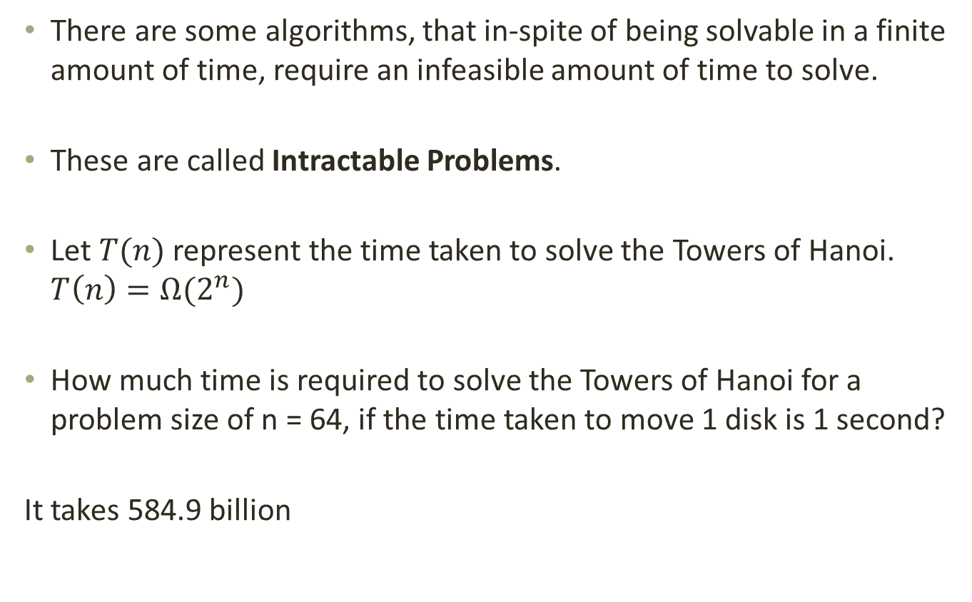
Intractability
There are some algorithms, that in-spite of being solvable in a finite amount of time, require an infeasible amount of time to solve.
These are called Intractable Problems.
Let $T(n)$ represent the time taken to solve the Towers of Hanoi. $T\left(n\right)={Ω(2}^{n})$
How much time is required to solve the Towers of Hanoi for a problem size of n = 64, if the time taken to move 1 disk is 1 second?
It takes 584.9 billion

Slide 4
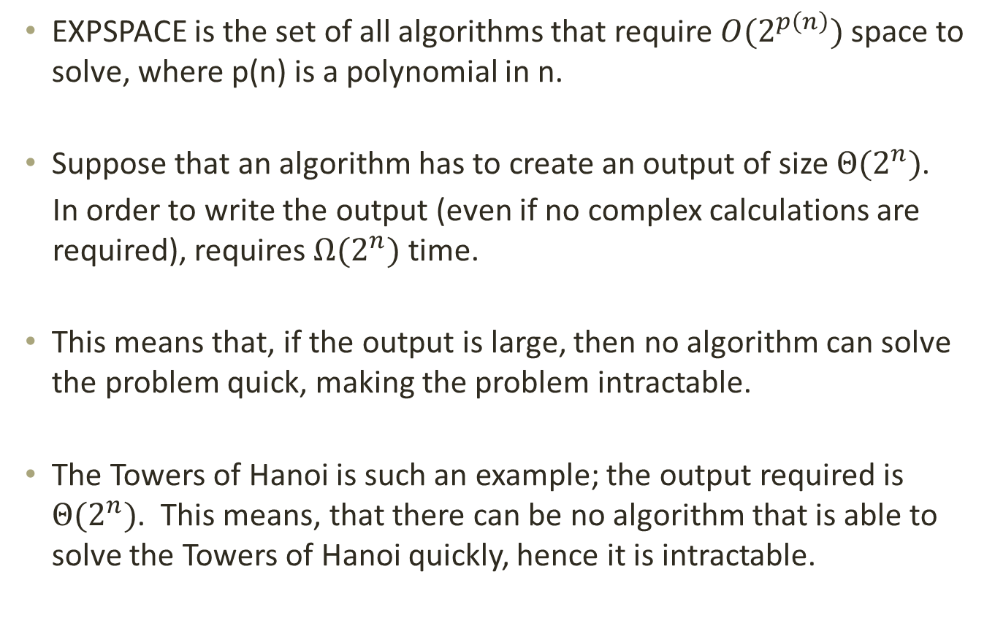
EXPSPACE
EXPSPACE is the set of all algorithms that require $O(2^{p\left(n\right)})$ space to solve, where p(n) is a polynomial in n.
Suppose that an algorithm has to create an output of size $Θ(2^{n})$.
In order to write the output (even if no complex calculations are required), requires $Ω(2^{n})$ time.
This means that, if the output is large, then no algorithm can solve the problem quick, making the problem intractable.
The Towers of Hanoi is such an example; the output required is $Θ(2^{n})$. This means, that there can be no algorithm that is able to solve the Towers of Hanoi quickly, hence it is intractable.

Slide 5
Notable Intractable Problems and P=NP?
Some intractable problems are very interesting and have been studied a lot. An efficient solution for these problems would be very useful!
Stephen Cook formally posed the problem of whether P = NP and asks whether a certain class of problems could be solved in polynomial time.
To this day, it is still not known whether or not P = NP.
A class of problems, called NP-Complete problems are of particular interest. This is because solving one of these problems in polynomial time, would make every problem in NP also solvable in polynomial time.

Slide 6
Notable Intractable Problems and P=NP?
While it is not known whether NP-Complete problems can be solved in polynomial time;
If you are given a solution to an NP-Complete problem, it is possible to verify whether or not it is a correct solution in polynomial time.

Slide 7
Notable Intractable Problems and P=NP?
Some well known NP-Complete problems include:
SAT (Boolean satisfiability problem)
CSAT (Circuit satisfiability problem)
TSP (Travelling Salesman Problem)
Knapsack Problem
Subgraph Isomorphism Problem
For further reading, refer to Chapter 34 of Introduction to Algorithms

Slide 8
Summary
Intractability
EXPSPACE
Notable Intractable Problems and P=NP?

Slide 9
End of lesson
Any questions?

